Slide 1
Monjolo: An Energy-Harvesting Energy Meter Architecture
Sam DeBruin, Brad Campbell, Prabal Dutta
University of Michigan
SenSys 2013 – November 13, 2013

Slide 2
Energy-harvesting power supplies are not batteries.
intermittency
unpredictability
Notes:
Start with statement about the area
Quote
Solve the scale issue
Characterized by two items
Analogy to solar power for the power grid, over provision
Im going to present a system that does not apologize
In fact, it thrives on the properties of eh power supplies
----- Meeting Notes (11/13/13 00:48) -----
do not apologize
try to mask the intermittency and predictability
same reasons wind and solar are not adopted
same reasons we dont use energy harvesting
overprovisioning
let them be intermittent

Slide 3
Previous Work: Indoor Energy-Harvesting Node
<gecko image with t, h, l sensors circled (labeled?)>
<gecko graph>
“this node nominally has a common suite of sensors.”
More Wakeups →
Brighter →
Lohit Yerva, Brad Campbell, Apoorva Bansal, Thomas Schmid, and Prabal Dutta. Grafting energy-harvesting leaves onto the sensornet tree. IPSN '12
Notes:
Save broad for the end

Slide 4
This Concept Extends Beyond Indoor Light
Energy consumers we wish to meter
emit side channels of harvestable energy
indoor lighting, AC loads, heating
light, electromagnetic fields, temperature gradients
Notes:
Community has been missing this key insight

Slide 5
We claim we can use these side channels to build energy-harvesting sensors.

Slide 6
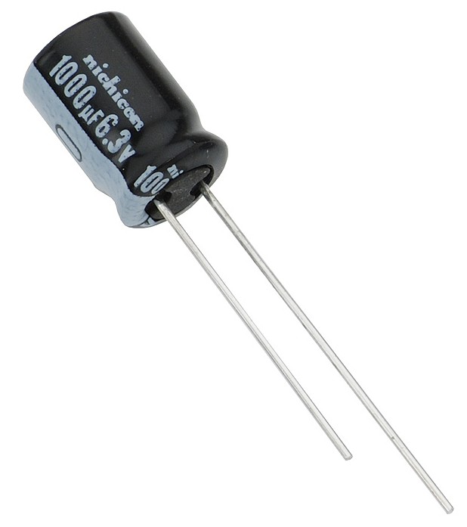
The Energy-Harvester is the Primary Sensor
packets
V
threshold
Central Receiver
Time
Monjolo
Notes:
Multiple charge decharge cycles
Add split core picture/video/demo
Inverval vs frequency

Slide 7
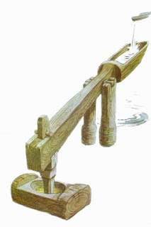
Notes:
The hammer rate depends on the water flow.
You could even think of a monjolo as a water meter

Slide 8
The Monjolo Architecture
M
M
Receiver
Server
M
Graph
Monjolo nodes are attached to ceiling lights, plug loads, etc.
Receiver tunnels packets to server.
Server calculates packet frequency or other metrics.
Data is streamed to the user.

Slide 9

We Evaluate this Architecture with a Power Metering Application
Power Supply
Node
Core
Linear LTC3588
EPIC
Current transformer frontend
Rectifying power supply
Microcontroller and radio
Notes:
Convince people that this isn’t a stupid take on this (monjolo)
We can do the split core version -> which is a very useful example that there isnt another solution. Non intrusive.
Ac-dc Power supply for meters and complexity <- create slide for this
power supply is vastly simpler
Intrinsically safer, no interrupt in ac lines

Slide 10
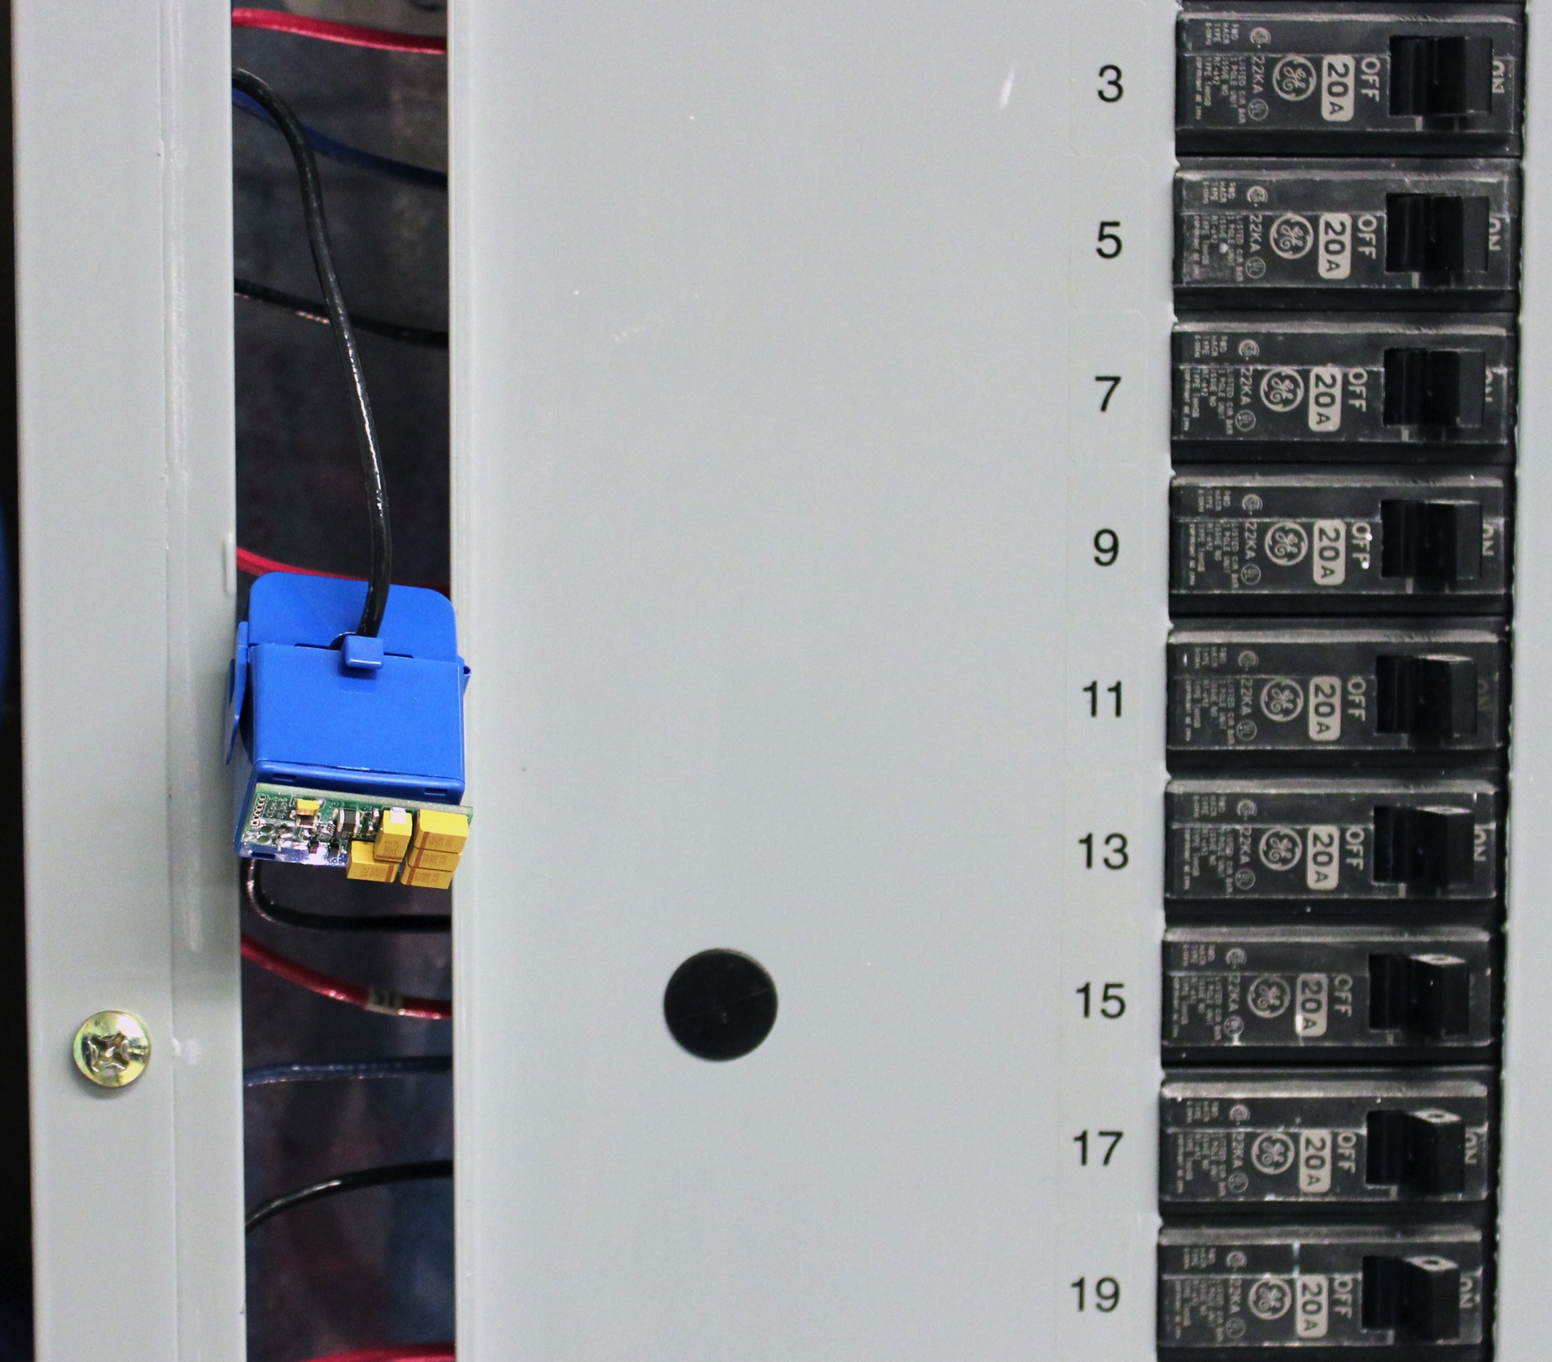
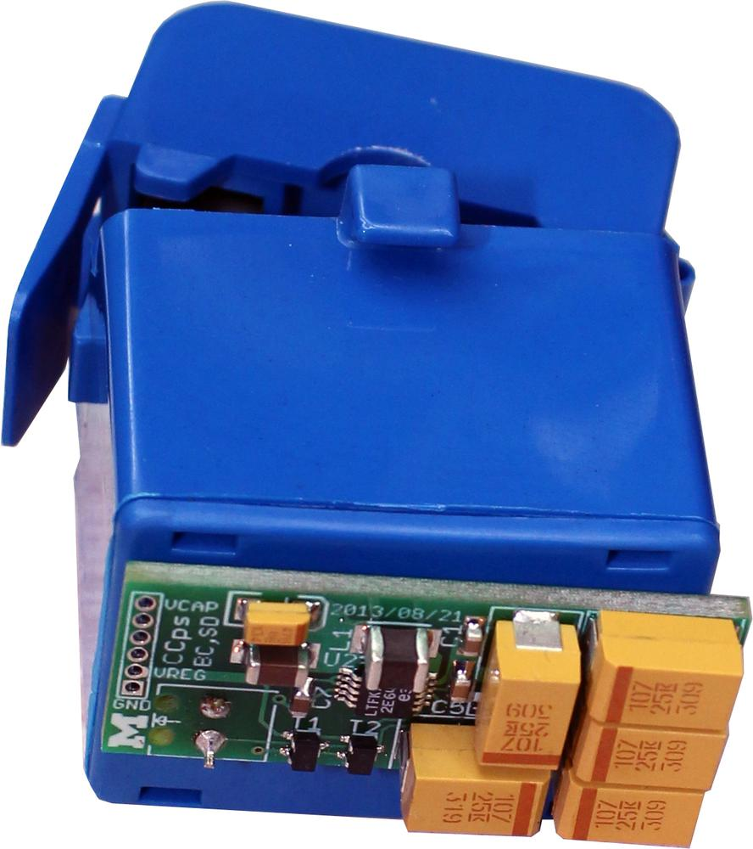
Energy-Harvesting Power Meter is Useful Even Near Mains Power
Vastly simplifies circuit level implementation
Zero power when the load is off
No high voltage AC-DC converter
Simple hardware and software
Intrinsically safe, non-contact sensor

Slide 11
Design Challenges of This Sensing Style
Packet Loss
Channel Flooding

Slide 12
Packet Loss will Change the Calculated Frequency
packets
frequency
time
Notes:
----- Meeting Notes (11/13/13 00:55) -----
add slides for outline and break this up

Slide 13
Packet Loss will Change the Calculated Frequency
Power Supply
Node
Core
Linear LTC3588
EPIC
FRAM
Increment a counter on each activation
Transmit the counter in the packet
Notes:
What is fram -> nonvolatile and fast write cycle (why fram?)

Slide 14
Rapid Activations will Flood the Wireless Channel
packets node #1
packets node #2
packets node #3
time

Slide 15
Rapid Activations will Flood the Wireless Channel
Power Supply
Node
Core
Linear LTC3588
ADC
EPIC
FRAM
Charge a capacitor on each transmission
Only transmit when the capacitor is below a threshold

Slide 16
Monjolo Node Design
Power Supply
Node
Core
Linear LTC3588
ADC
EPIC
FRAM

Slide 17
Evaluation

Slide 18
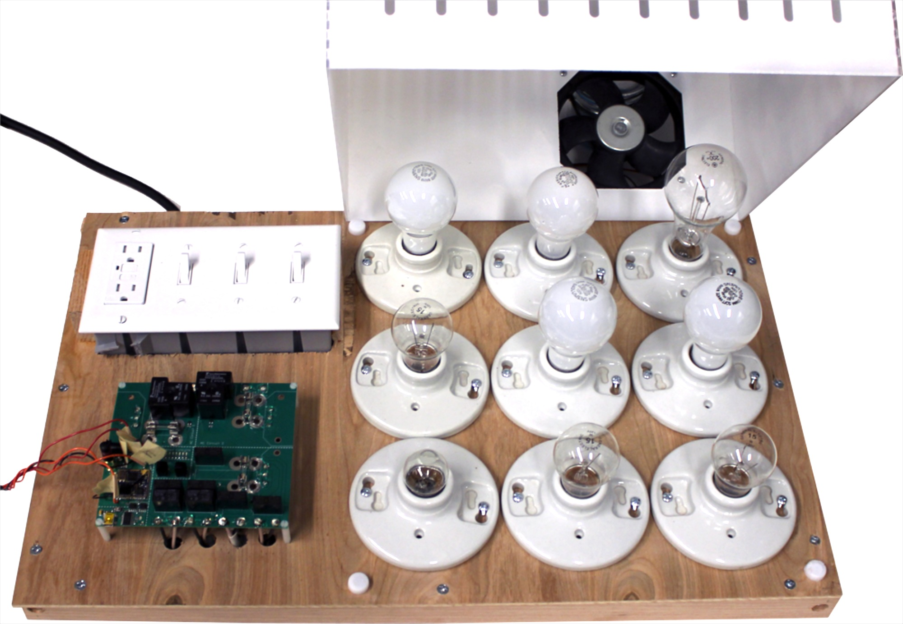
Activation Frequency Increases Monotonically with Load Power
Notes:
Speak more to calibration. Note that we calibrate at build time and load that calibration function to the cloud. Then the central receiver can use that calibration based on the ID when determining the power load.

Slide 19
Power Meter Tracks a Fully Resistive Load with 3% Error
Notes:
Get rid of error graph
----- Meeting Notes (11/13/13 01:04) -----
we evalute monjolo against ground truth and it works quite well for resistive loads

Slide 20
Changing Power Factor Leads to Magnitude Errors
Notes:
Add apparent power discussion

Slide 21
Packet Loss Causes Minimal Error
Notes:
Add error graph

Slide 22
Timing Capacitor Limits Packet Transmission Rate

Slide 23
The Power Meter is Relatively Inexpensive
Component | Cost (Quantity: 10k)
MSP430G2152 | $1.72
LTC3588 | $3.58
CC2420 | $4.20
FRAM | $1.05
Harvesting coil | $5.02
Storage Capacitors | $4.60
Other Components | $1.17
PCB | $0.97
Packaging | $5.23
Total | $27.54
Device | Cost
Monjolo | $27.54
Kill-A-Watt | $29.95
Kill-A-Watt Wireless | $34.99
iMeter Solo | $39.99
Watts up? | $95.95
Watts up? .Net | $235.95
Notes:
Cc2420…don’t need. Use low power long range radios, smaller?
Security + privacy
encrypt source
randomize transmission interval, counter is still useful but frequency isn’t

Slide 24
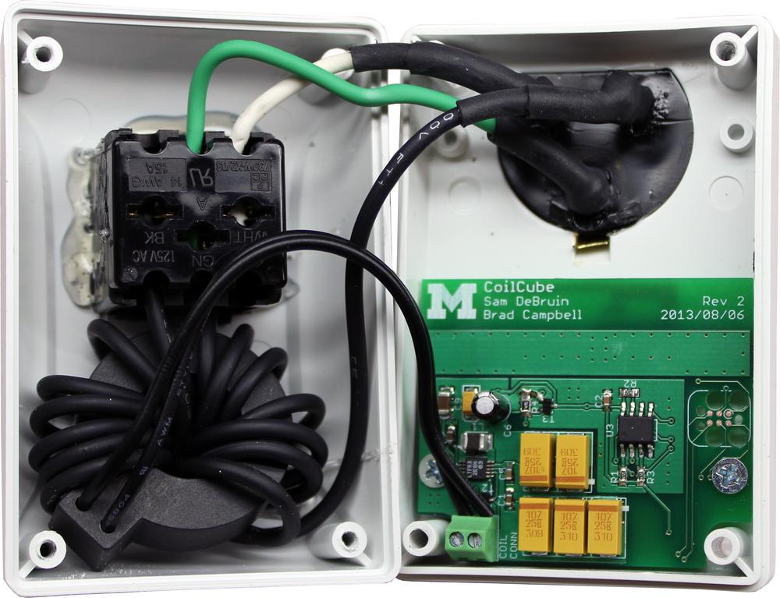
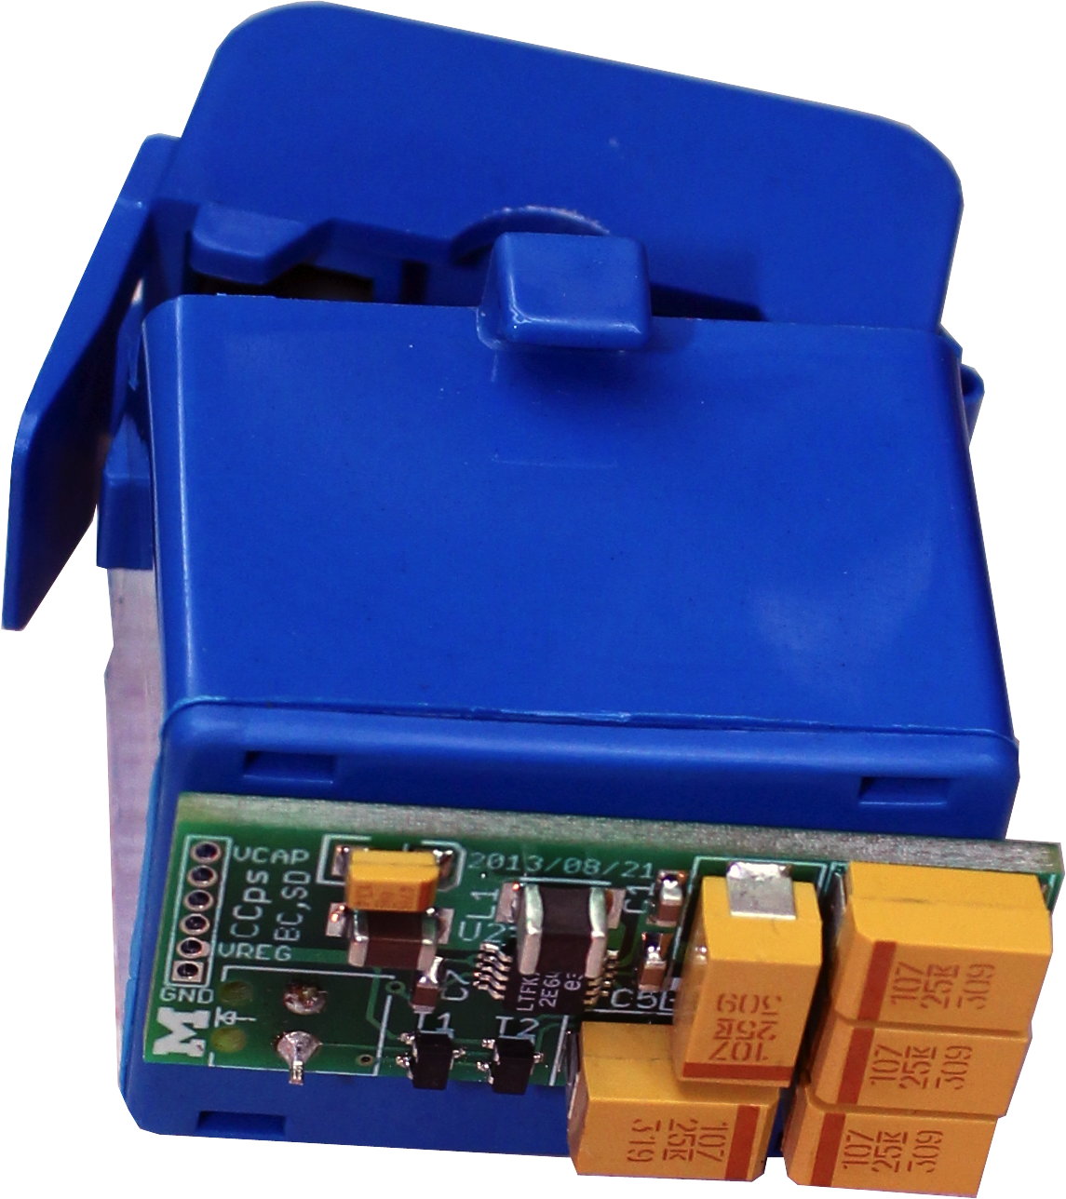

Physical Instantiation of the Power Meter
Notes:
Add related work somewhere
Add in panel meter picture

Slide 25
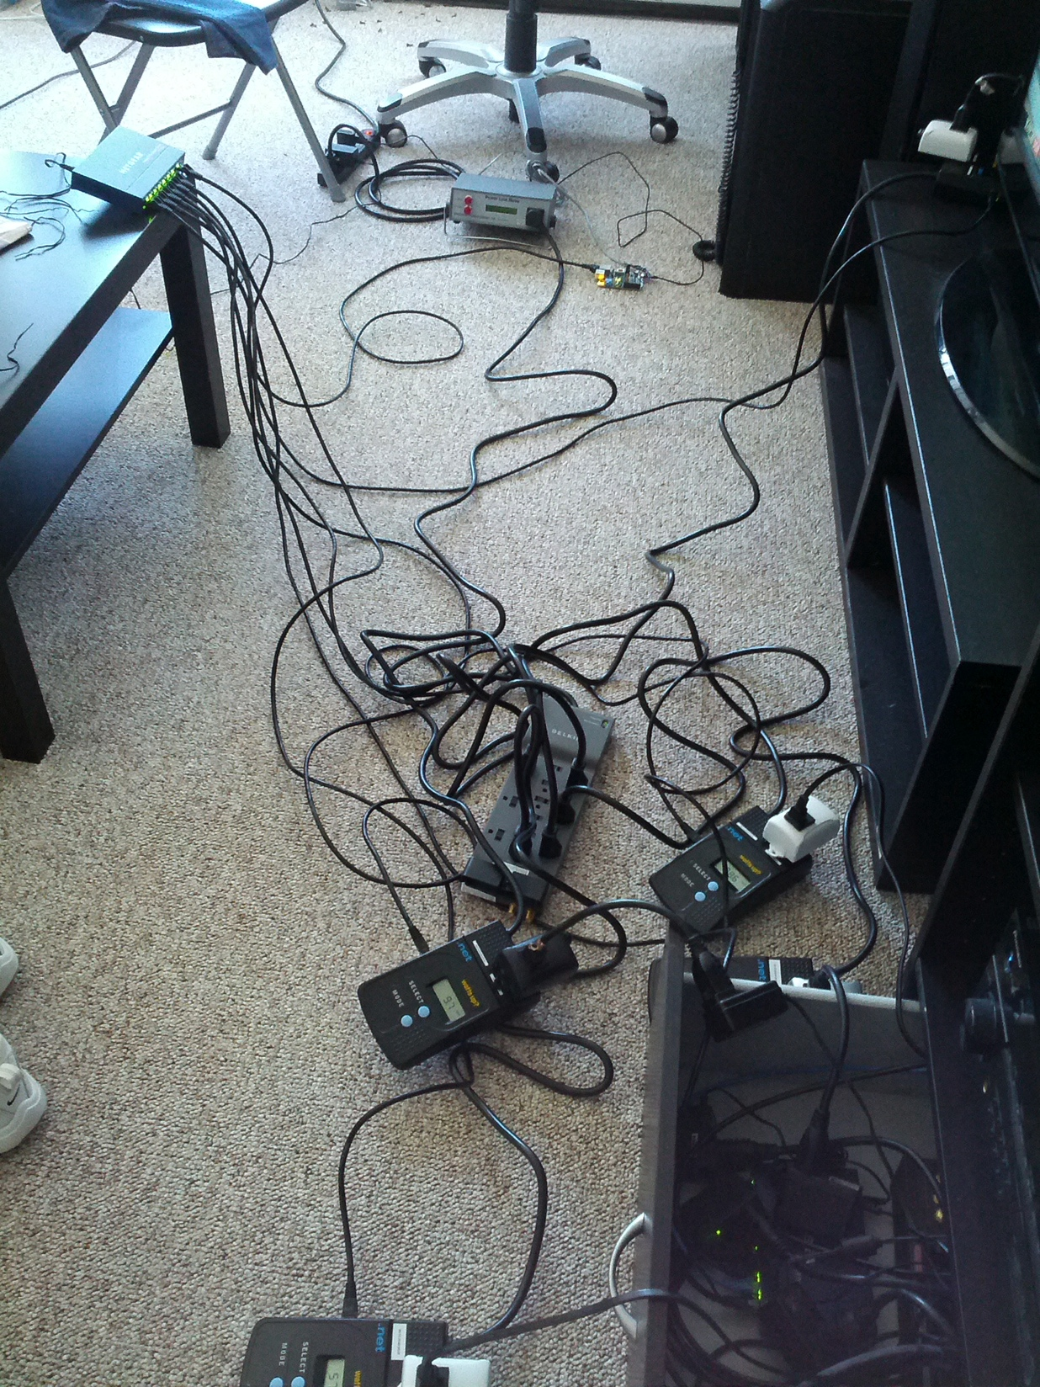
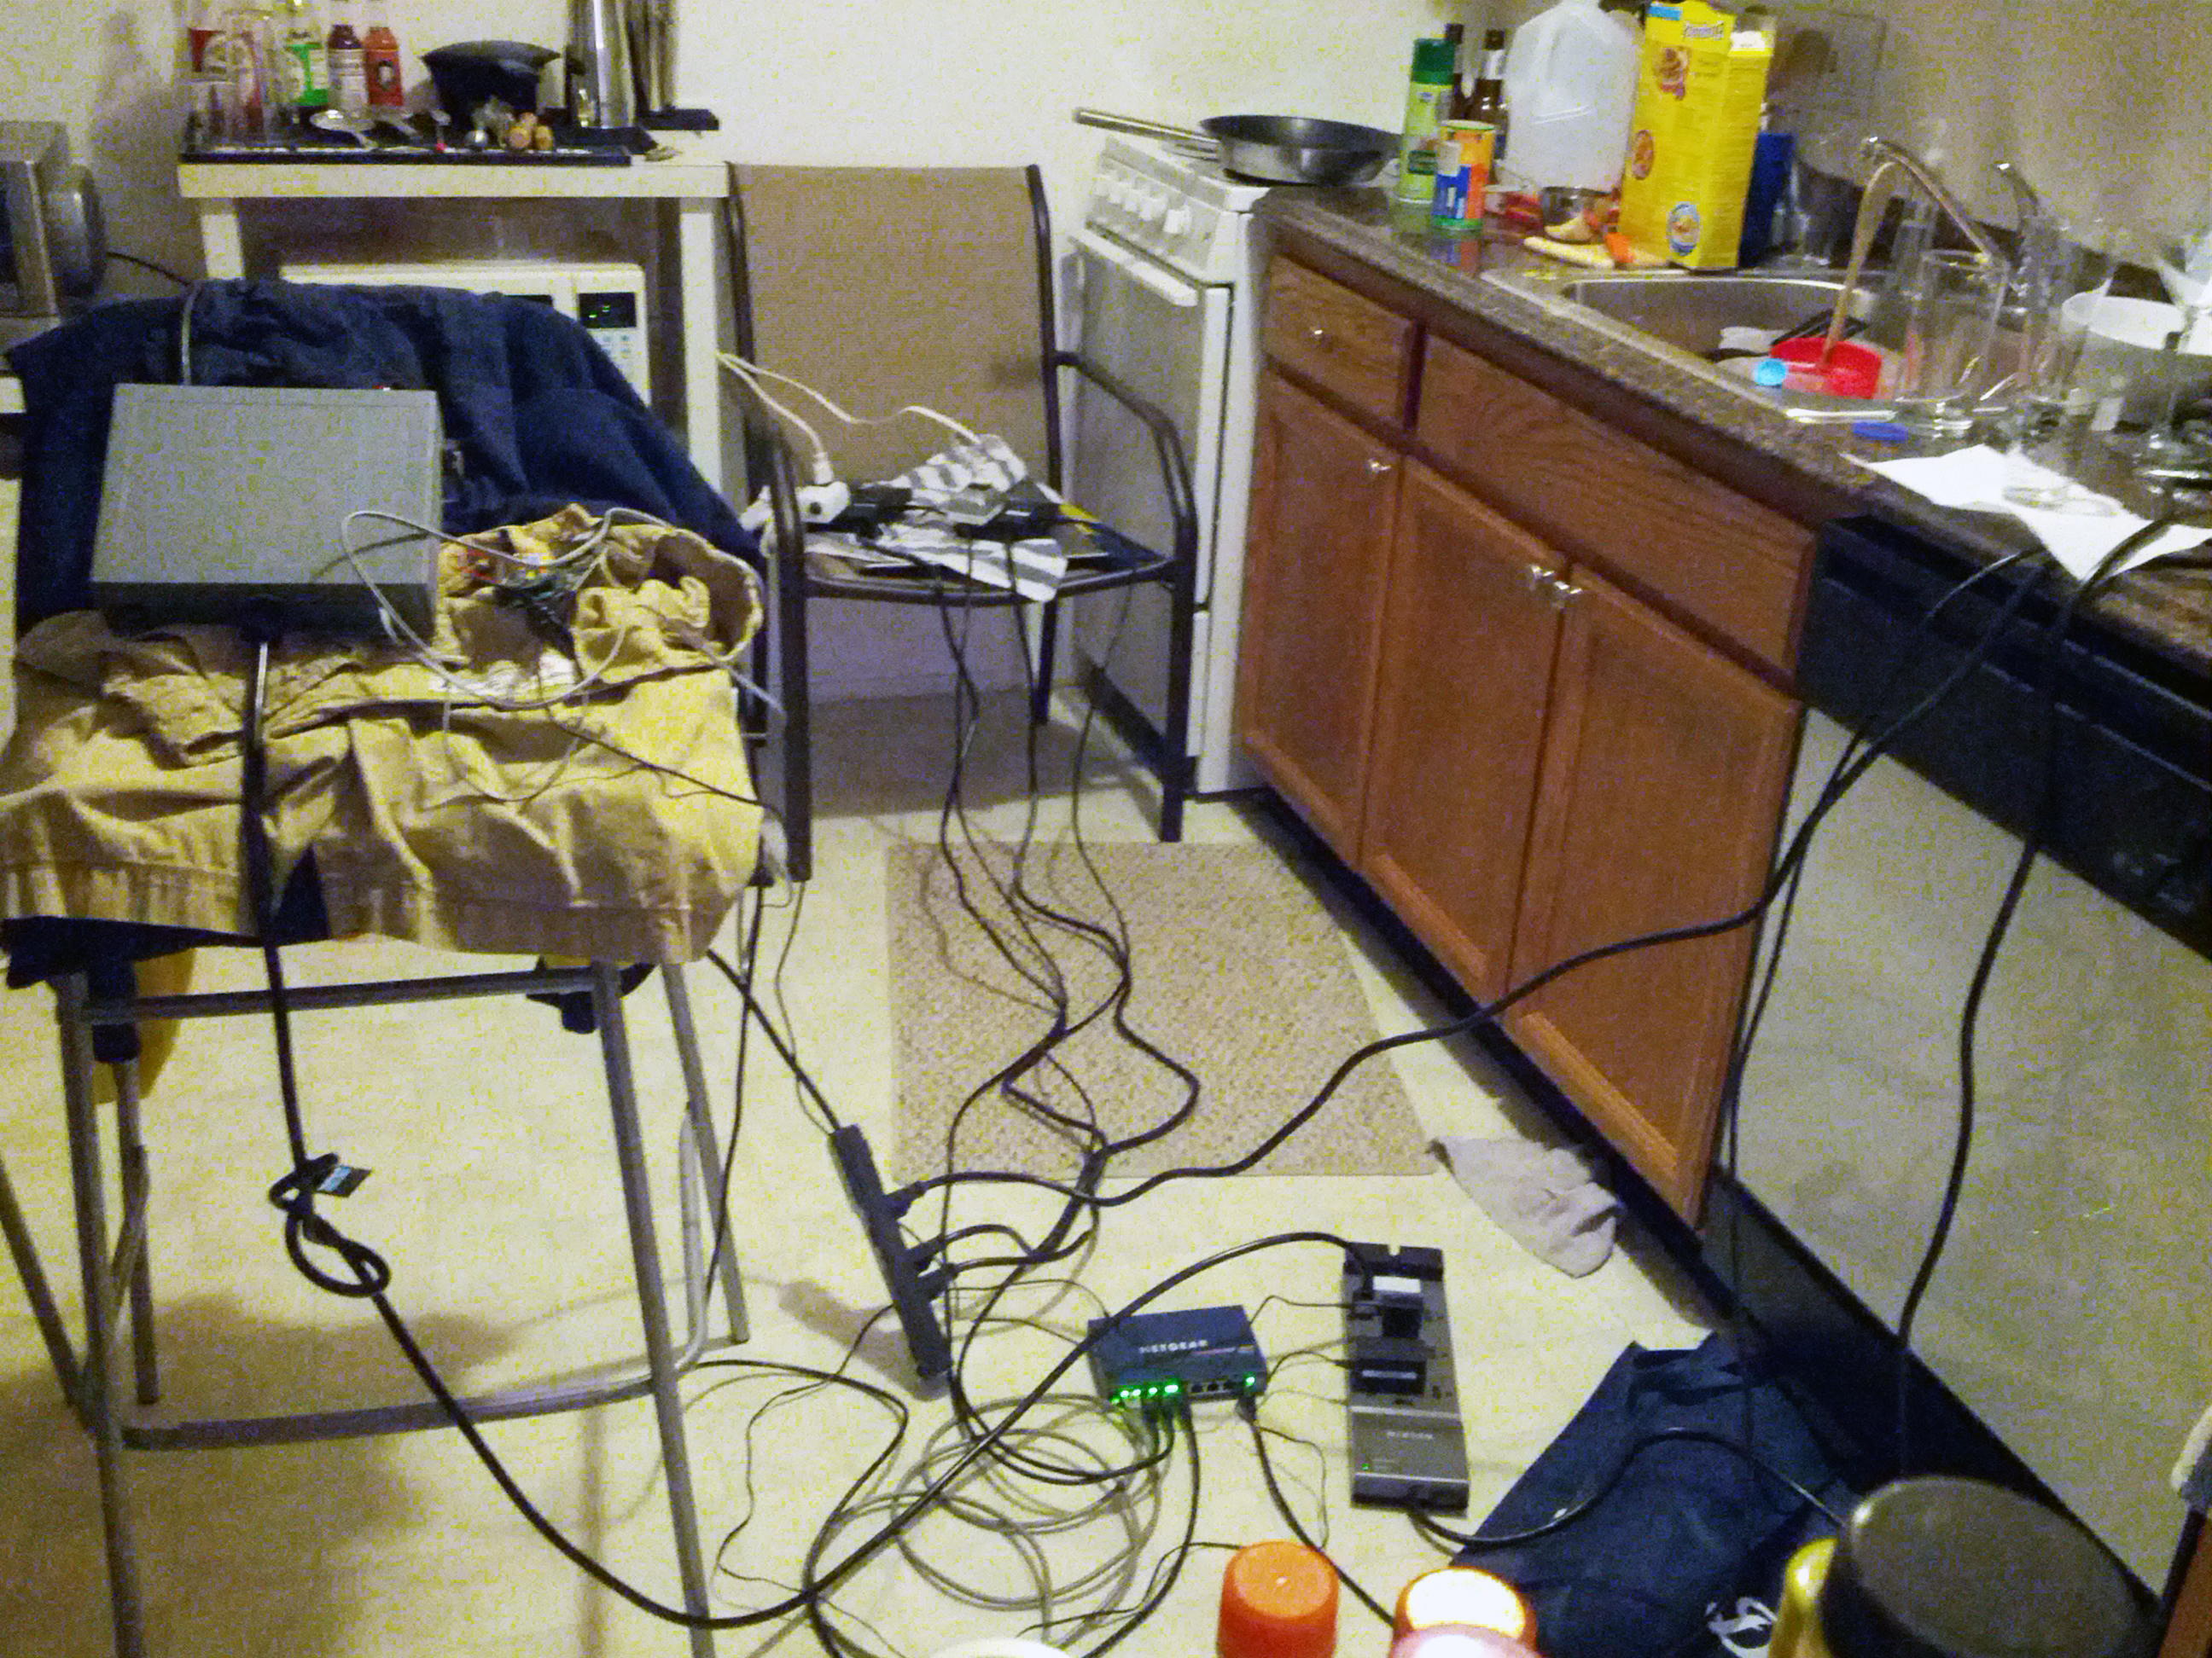
Testing The Monjolo Power Meter

Slide 26
Concrete Example: Kitchen Experiment
Packets stop

Slide 27
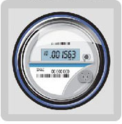
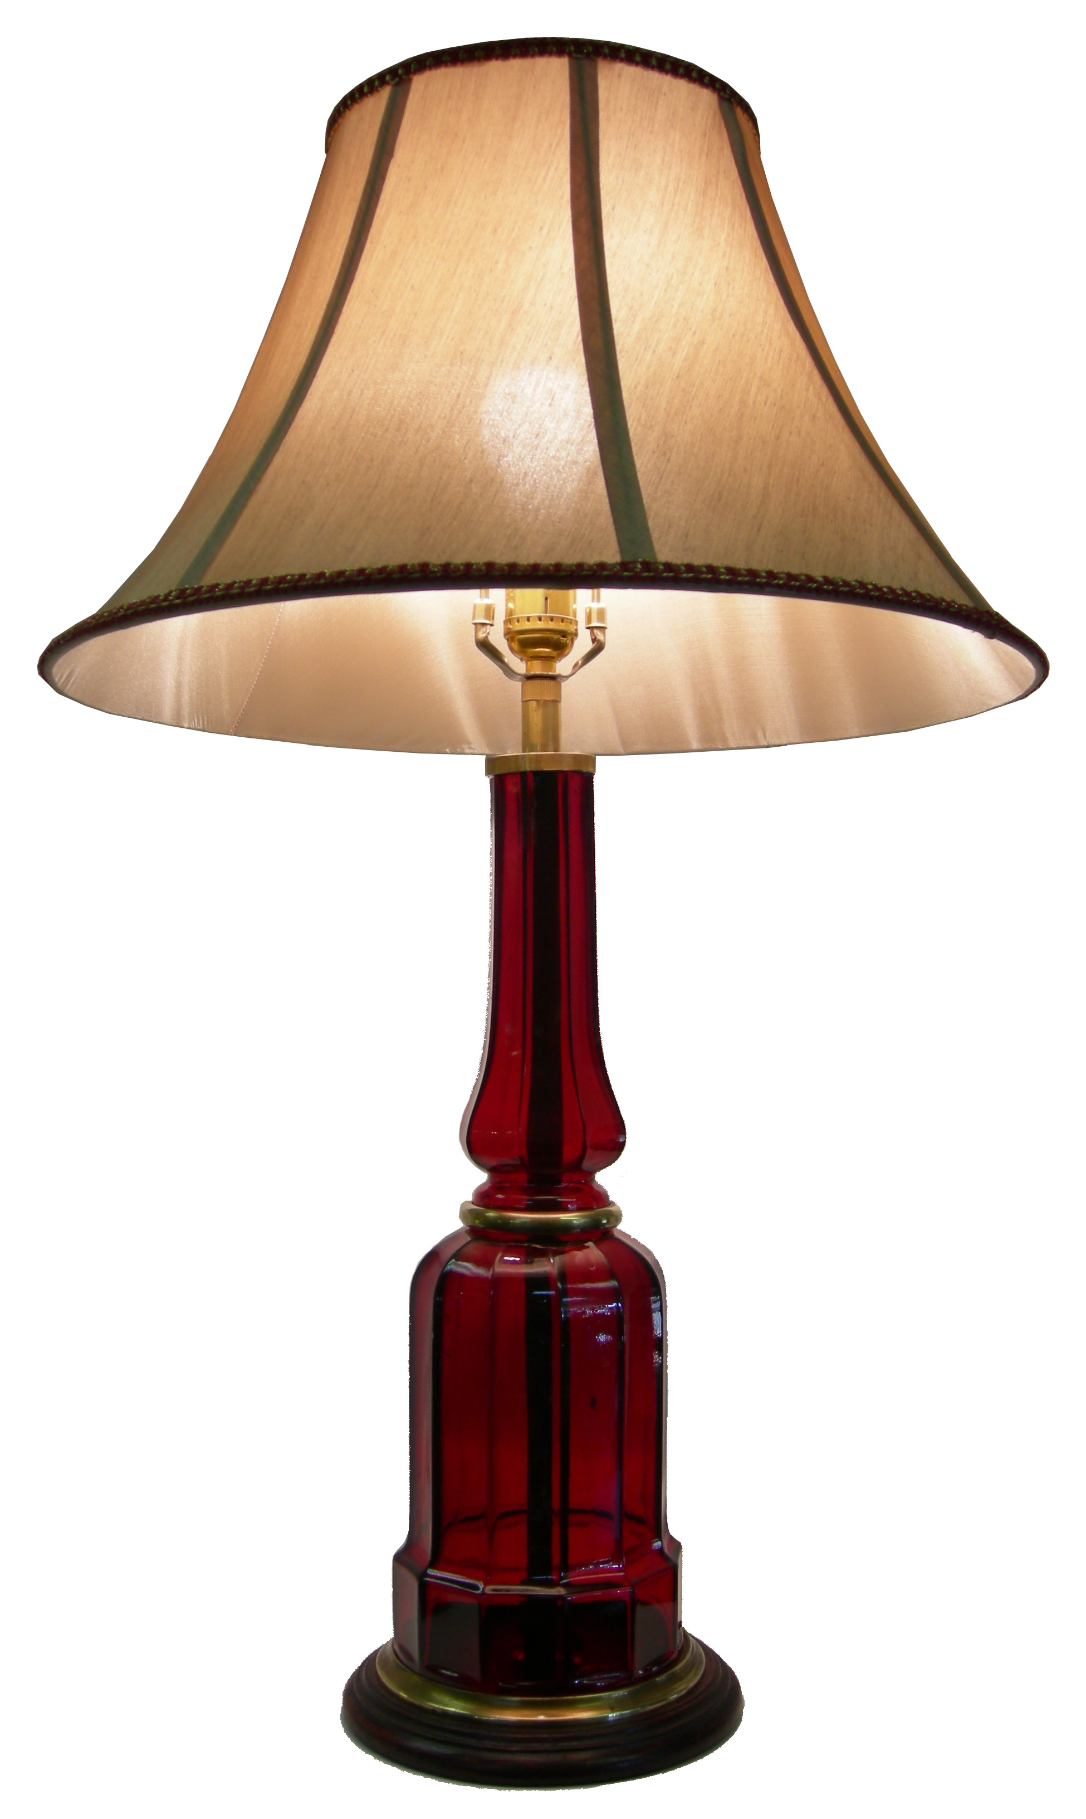
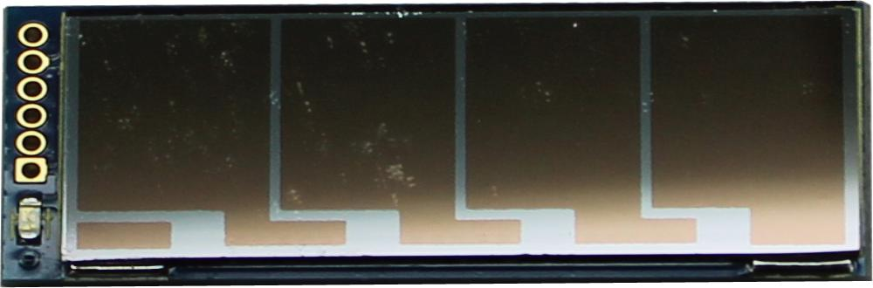

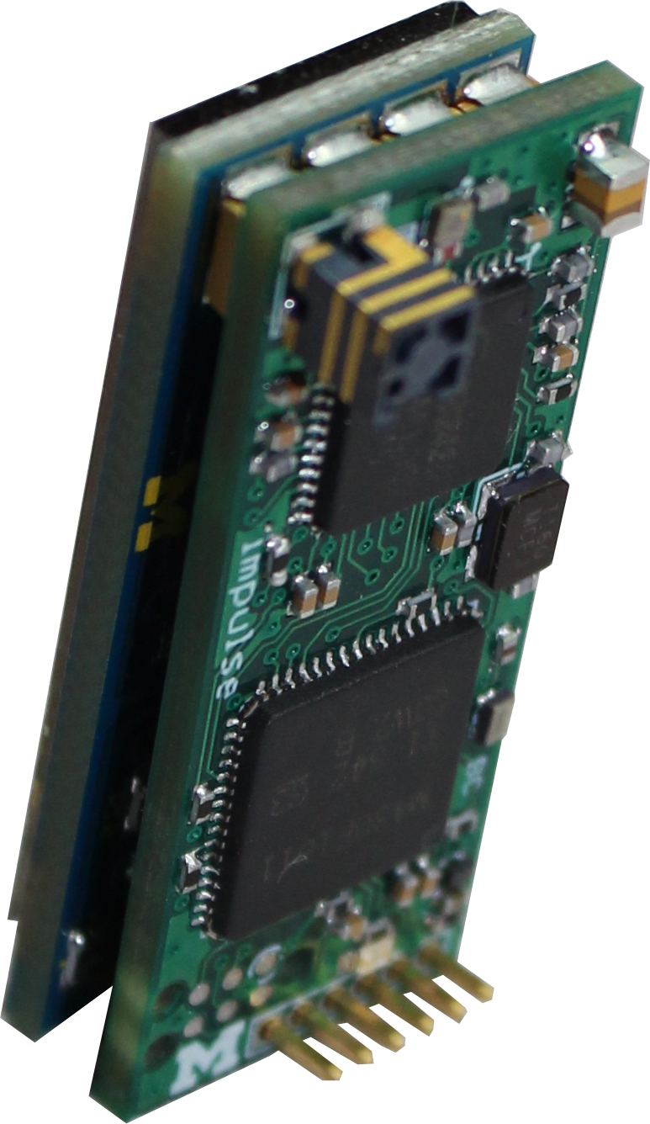
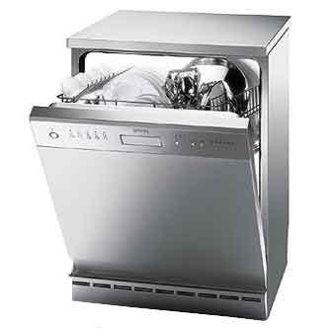

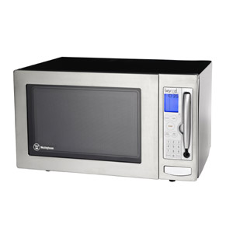
Addressing the Power Factor Issue and Future Work
Aggregate
Measurements
Aggregate
Meter
Server
Disaggregating power draw
Monjolo nodes
Calibrated total
Assign a portion of the total to each load
Individual
Power Draws
Notes:
Expand this

Slide 28
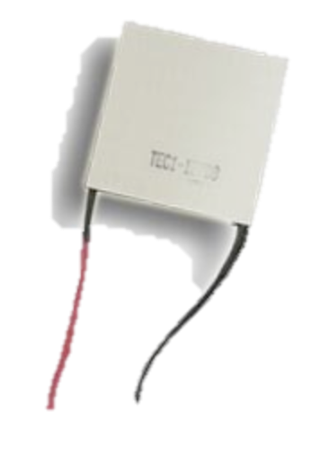
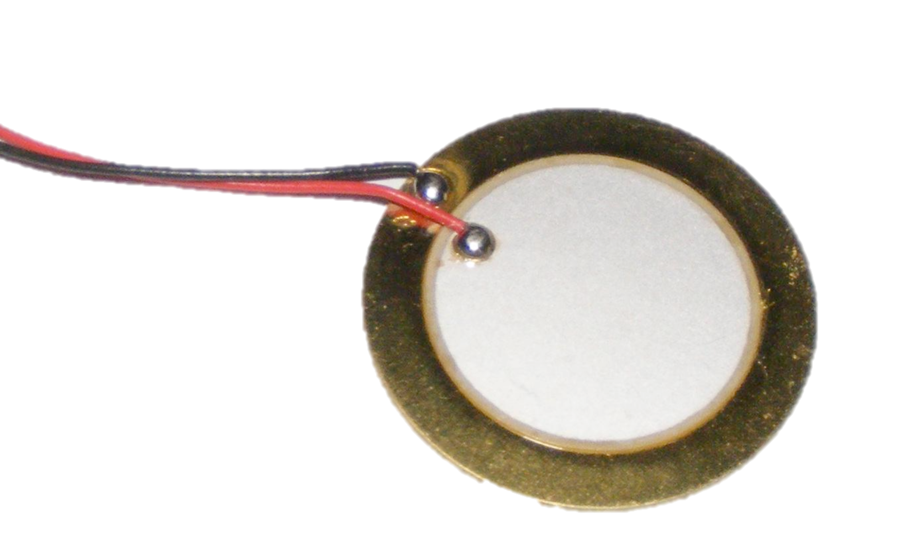
The Monjolo Principle Applies Beyond AC Load Meters
Power Supply
Node
Core
Linear LTC3588
ADC
EPIC
FRAM
Metering installed lighting
Metering hot water
Metering vibration or airflow
otherwise hard to meter
Notes:
Move this way up. Different energy sources can be metered
Point out hard to meter devices

Slide 29
Monjolo Represents a New Design Point for Sensor Nodes
Embraces what energy-harvesting gives us
Server-side sensing with sensor node hints
Demonstrated the architecture with a power meter
Monjolo principle applies to other energy sensing
Brad Campbell
University of Michigan
bradjc@umich.edu

